Slide 1

Text to Sequence
Notes:
‹#›

Slide 2
Objectives
Understand text to sequence in tensorFlow
Implement text to sequence
Text to Sequence
‹#›

Slide 3
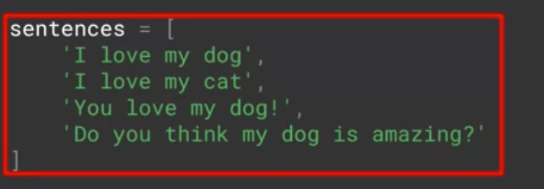
Text to Sequence
When we were doing images, we defined an input layer with the size of the image that we're feeding into the neural network. In the cases where images where differently sized, we would resize them to fit🡪 the same thing with text.
Discuss: which size is use for those sentences ?
Text to Sequence
‹#›
Notes:
‹#›

Slide 4
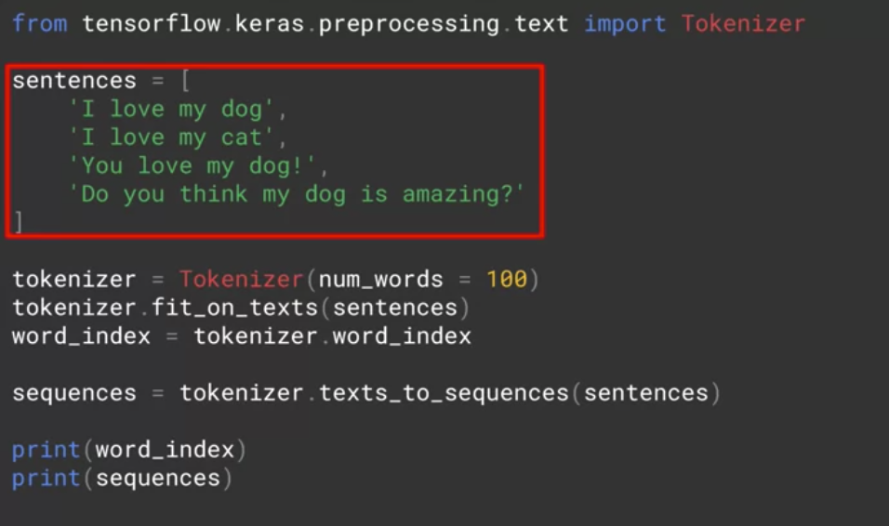
Text to Sequence
Added another sentence(bit longer) to the end of the sentences list
Text to Sequence
‹#›
Notes:
‹#›

Slide 5
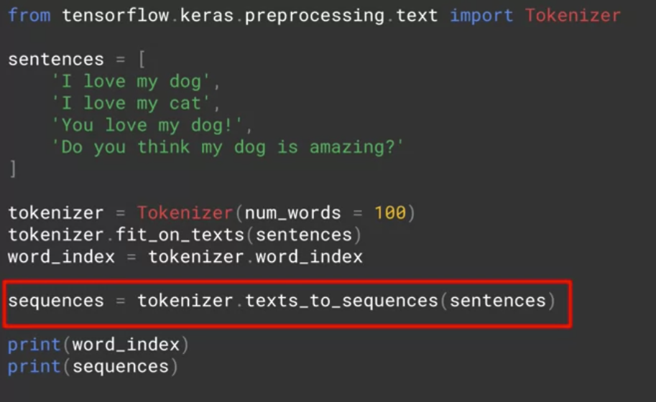
Text to Sequence
The tokenizer to get texts to sequences, and it will turn them into a set of sequences
Text to Sequence
‹#›
Notes:
‹#›

Slide 6
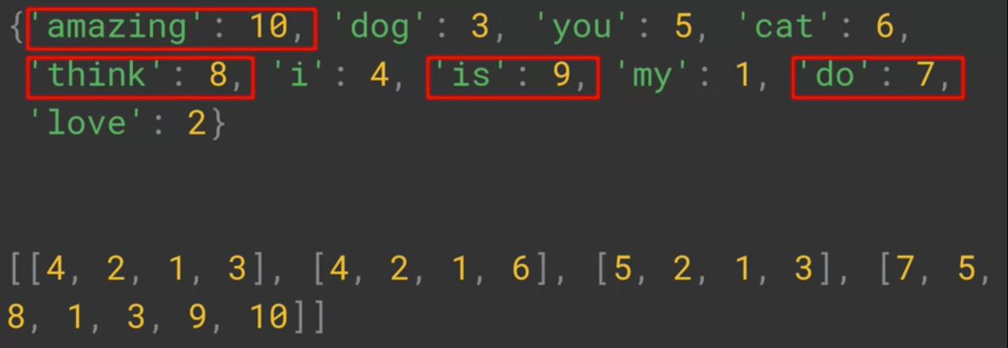
Text to Sequence
The results:
The top is the new dictionary
The bottom is my list of sentences that have been encoded into integer lists, with the tokens replacing the words
Text to Sequence
‹#›
Notes:
‹#›

Slide 7
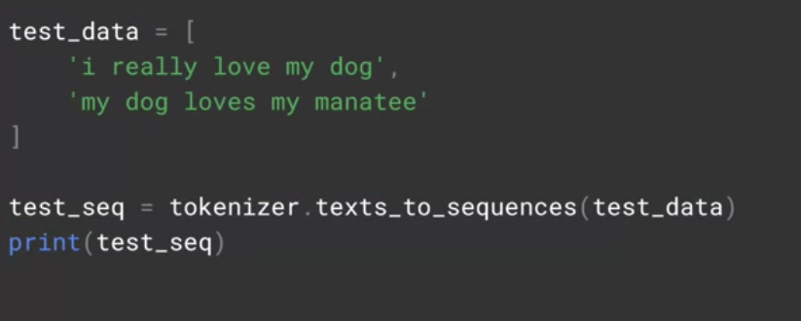
Text to Sequence
Discuss: what do you expect the outcome to be?
Text to Sequence
‹#›
Notes:
‹#›

Slide 8
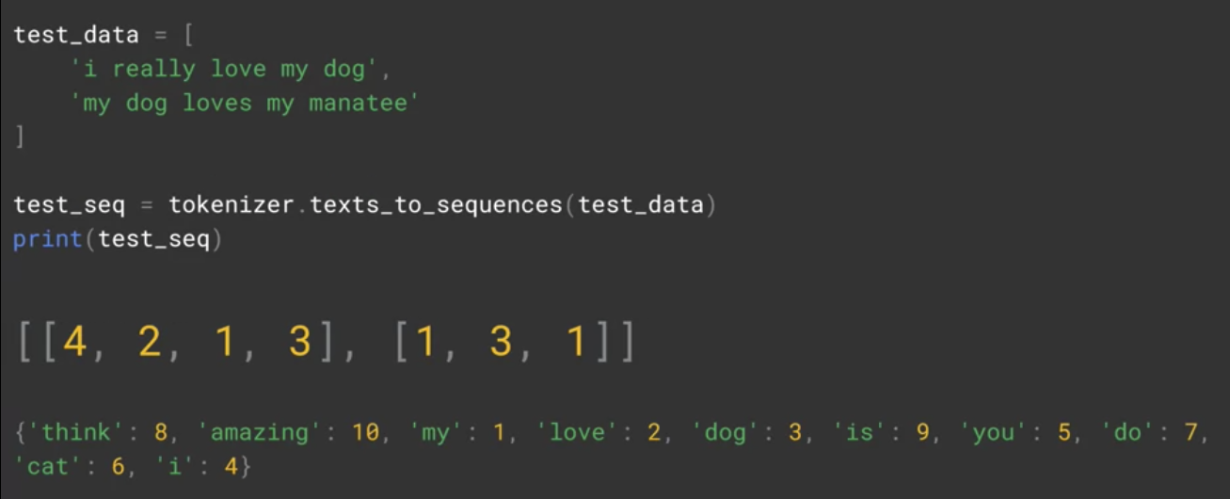
Text to Sequence
The results
Text to Sequence
‹#›
Notes:
‹#›

Slide 9
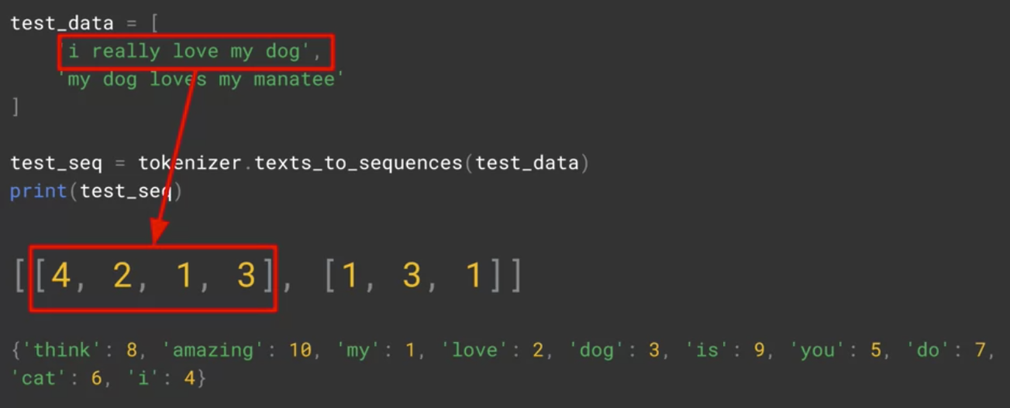
Text to Sequence
I really love my dog would still be encoded as 4, 2, 1, 3, which is 'I love my dog' with 'really' being lost as the word is not in the Word Index
Text to Sequence
‹#›
Notes:
‹#›

Slide 10
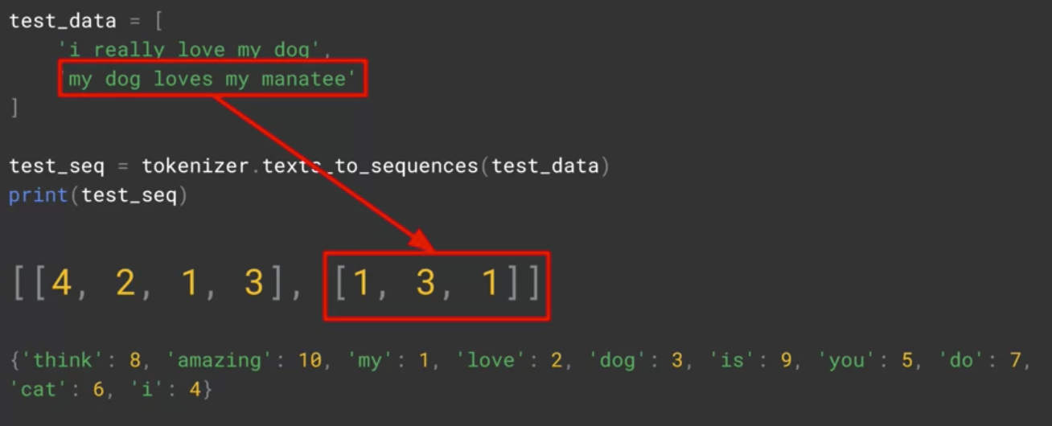
Text to Sequence
'my dog loves my manatee' would get encoded to 1, 3, 1, which is just 'my dog my'.
Text to Sequence
‹#›
Notes:
‹#›

Slide 11
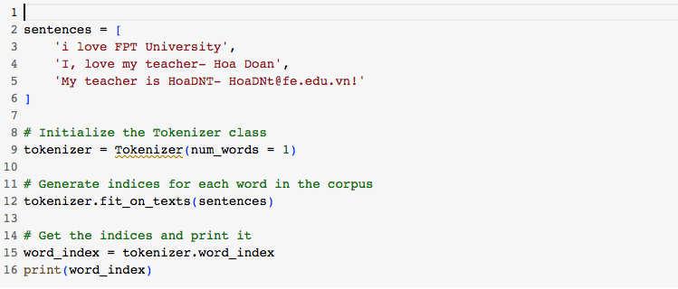
Text to Sequence
Try this code and give the result
Text to Sequence
‹#›
Notes:
This code missing the import libs🡪 run with error
‹#›

Slide 12
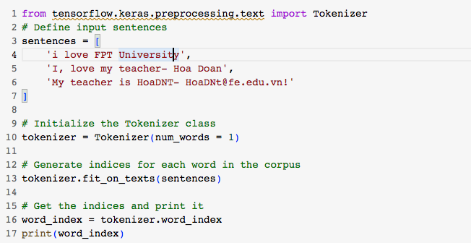
Text to Sequence
Try this code and show the result
Text to Sequence
‹#›
Notes:
‹#›

Slide 13
Summary
Understand text to sequence in tensorFlow
Implement text to sequence
Text to Sequence
‹#›

Slide 14
Q & A
Text to Sequence
‹#›

